Slide 1

HOUSE HUNT (Real Estate Web Application)
TEAM 1
NITANT PARESHBHAI BHAGAT
BHUMI ASHOKBHAI TADHANI
NAGA BAVANA KOLASANI
BHARGAV PATEL
HARSH DEEPAKKUMAR MODI
ABHISHEK SUNIL TAMBOLI
VRAJDEEP DILIPBHAI LUNAGARIYA
JENISHA BHAVESHBHAI GAJERA
MANISH THOTAKURA
SAI NADH BATTALAPALLI

Slide 2
Agenda
GitHub
Repo Structure
Pre-requisites
Code Snippets
Frontend
Backend
Deployment
Jenkins
Installation Guide

Slide 3
GitHub URL
https://github.com/abdtamboli/cs691-HouseHunt-team1

Slide 4
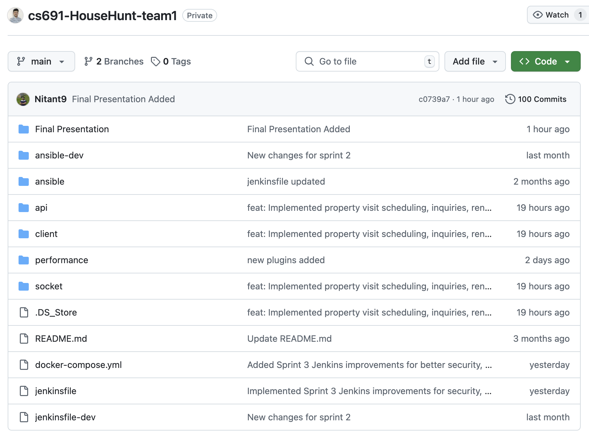
Repo structure
Final Presentation: Contains the final presentation materials for the project.
ansible-dev: Holds Ansible configuration and scripts used during development (Sprint 2 specific).
ansible: Contains core Ansible setup, including automation files like Jenkins file.
api: Backend logic for scheduling visits, inquiries, rental processes, etc.
client: Frontend React application for property listings and user interactions.
performance: Includes performance-related configurations or plugins.
socket: Handles real-time communication features such as live updates or notifications.
.DS_Store: macOS system file that stores folder view preferences (not project-related).
README.md: Documentation providing an overview and usage instructions for the project.
docker-compose.yml: Defines services and configurations to run the app using Docker.
jenkinsfile: CI/CD pipeline configuration for building, testing, and deploying the project.
jenkinsfile-dev: Jenkins pipeline used for development-specific builds or testing.

Slide 5
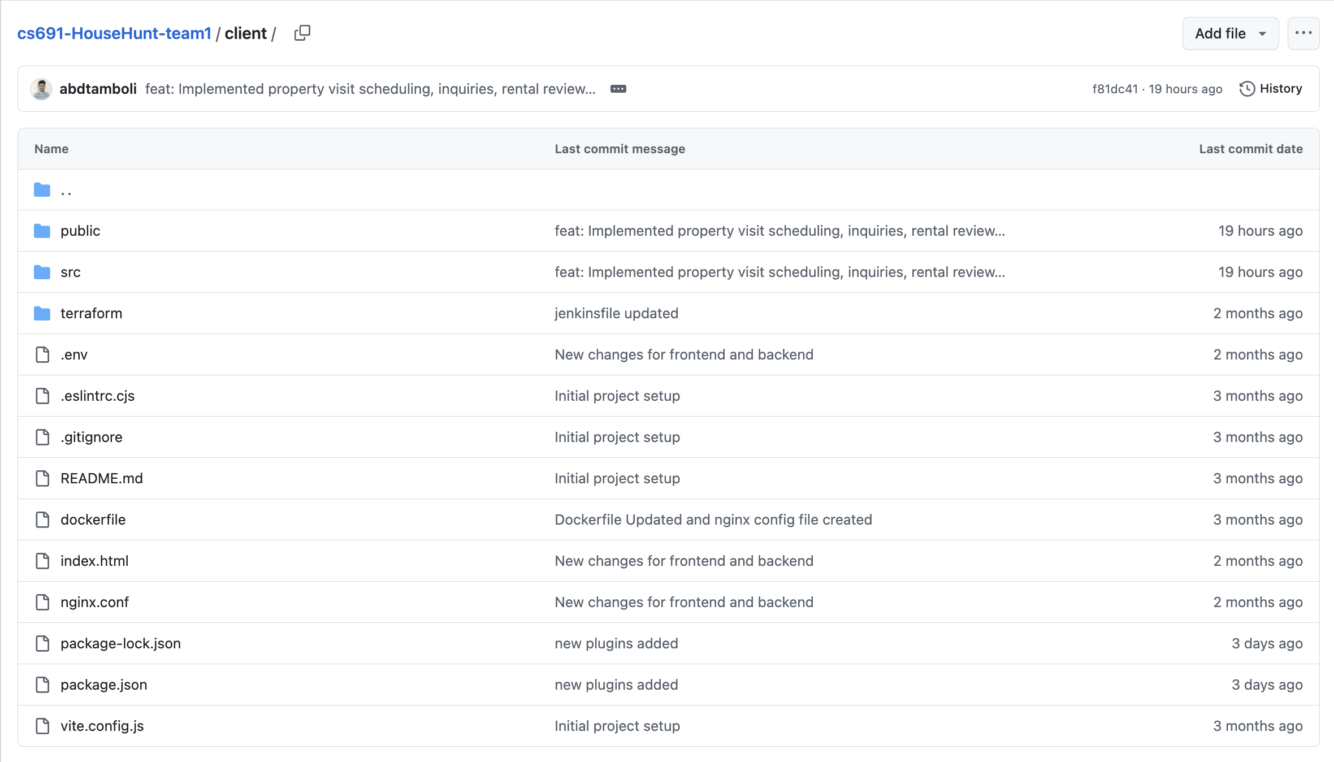
REPO STRUCTURE (CLIENT - FRONTEND)

Slide 6
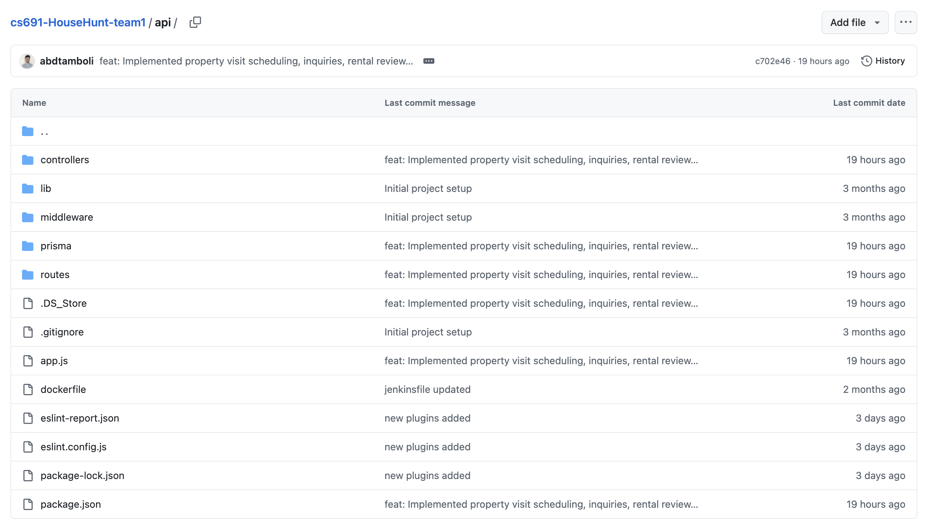
REPO STRUCTURE (SERVER - backend)

Slide 7
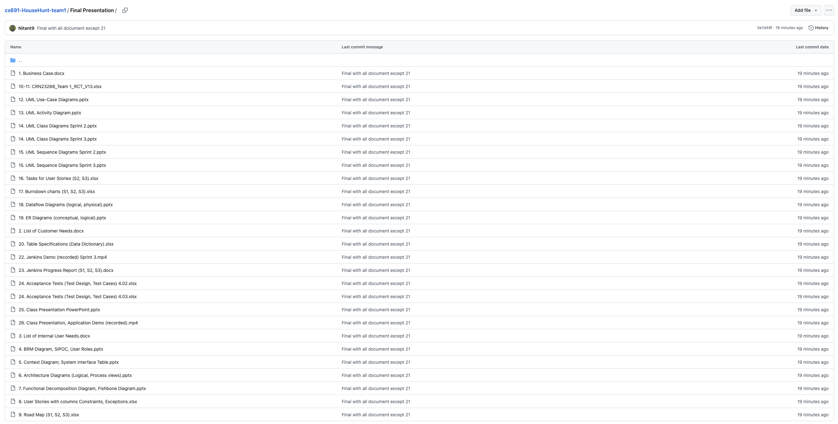
REPO STRUCTURE (final deliverables)

Slide 8




PRE-REQUISITES
MongoDB
React
IDEs for Frontend and Backend
Node.js

Slide 9
Installation guide
Clone the Repo
Backend Folder
Go to api folder and run the command [npm install]
Frontend Folder
Go to client folder and run the command [npm install]
And then [npm run dev]
Application Home
git clone https://github.com/abdtamboli/cs691-HouseHunt-team1
And then [nodemon app.js]
At localhost:3000, you will land on the homepage of HouseHunt.
Navigate through the application and its features.

Slide 10

Code snippets

Slide 11
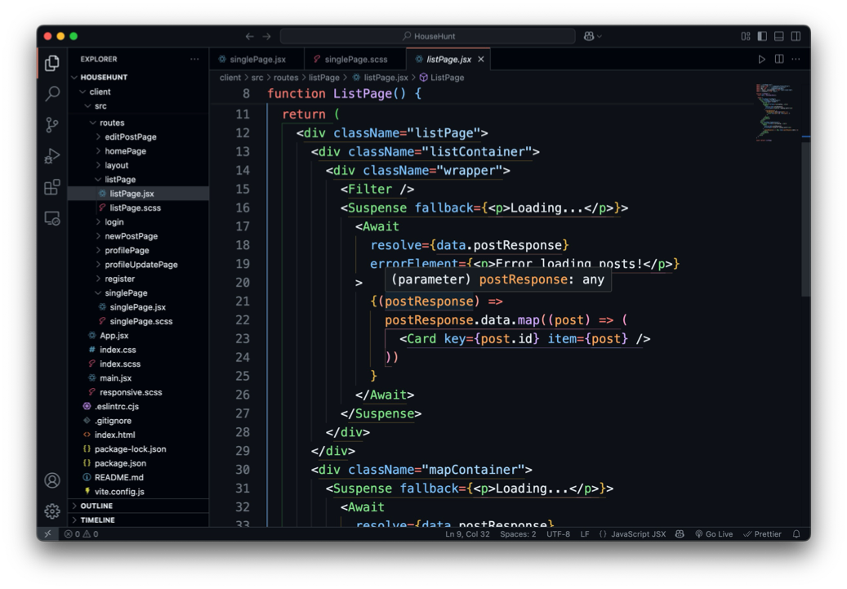
Properties (Listing of Properties - Frontend)

Slide 12
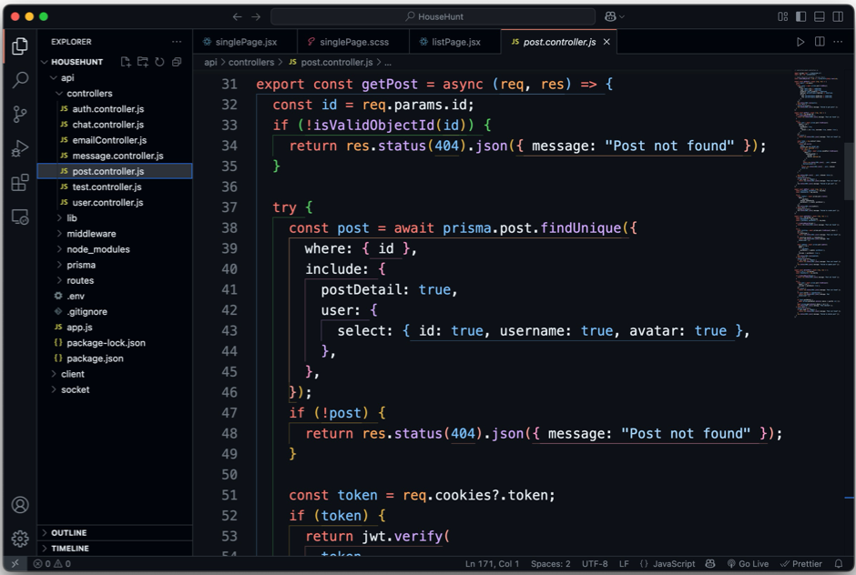
Properties (Backend)

Slide 13
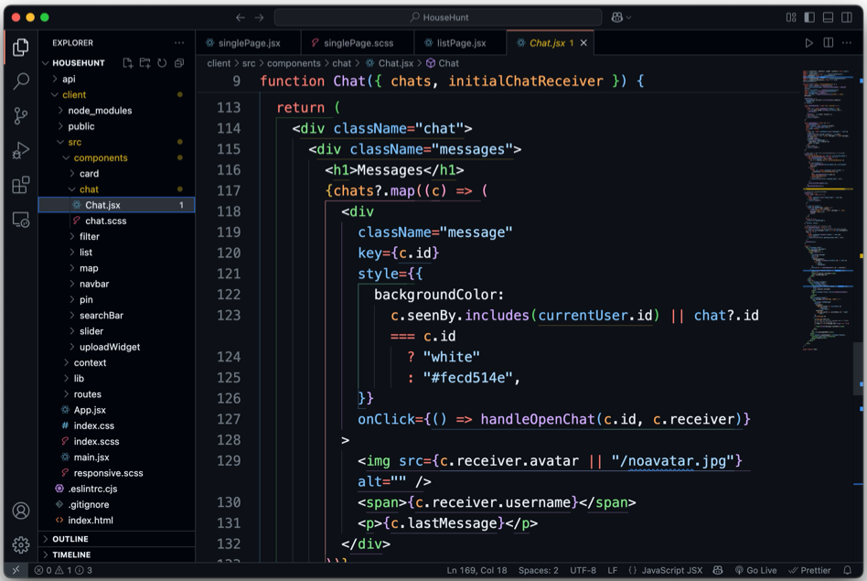
Chat (Frontend)

Slide 14
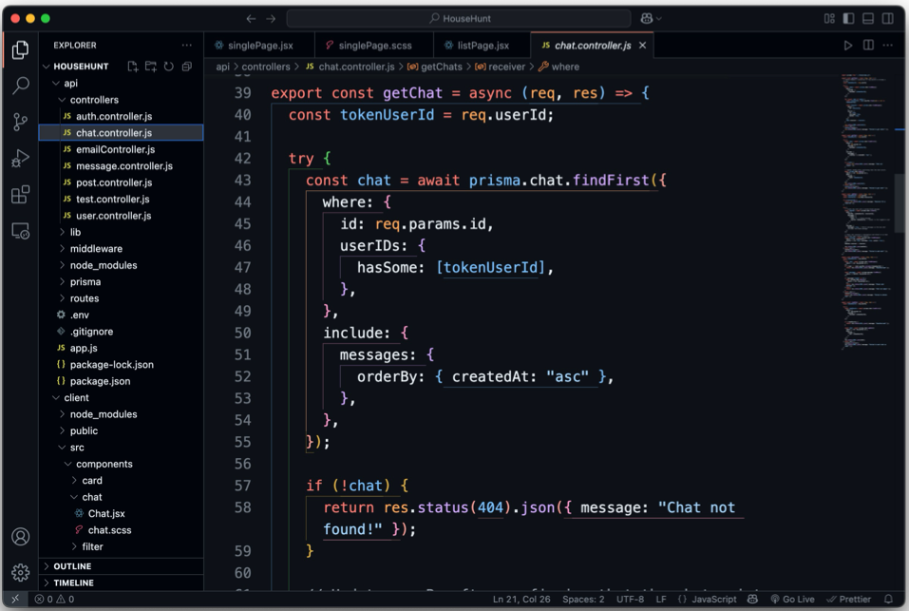
Chat (Backend)

Slide 15
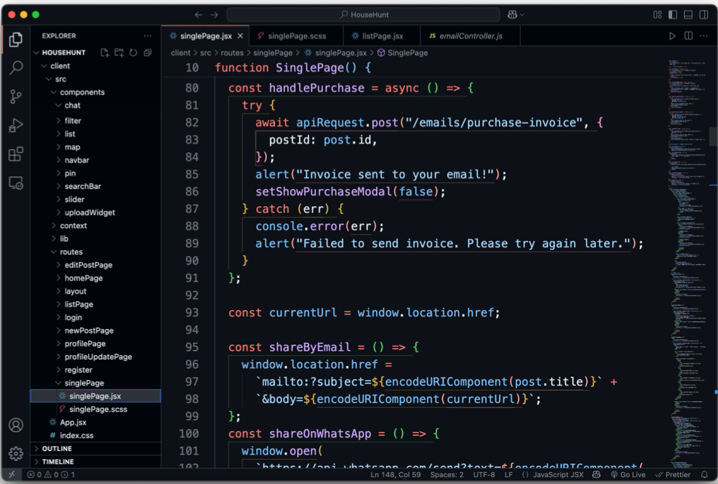
Invoice Generation (Frontend)

Slide 16
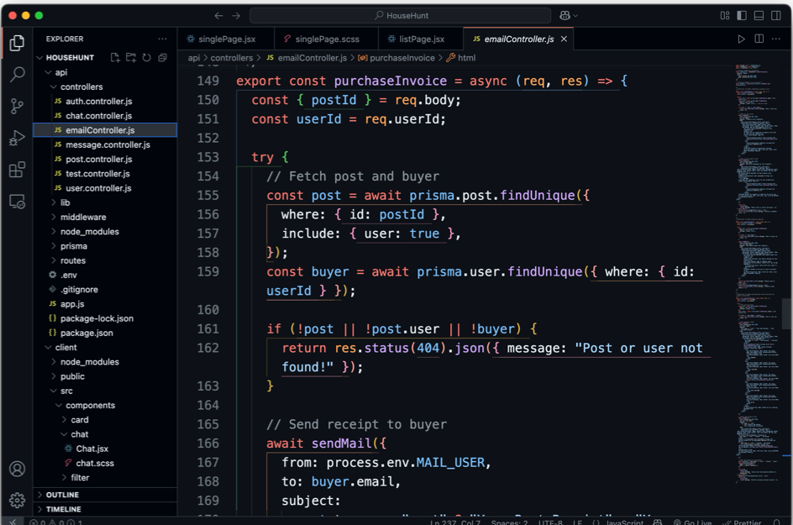
Invoice Generation (Backend)

Slide 17
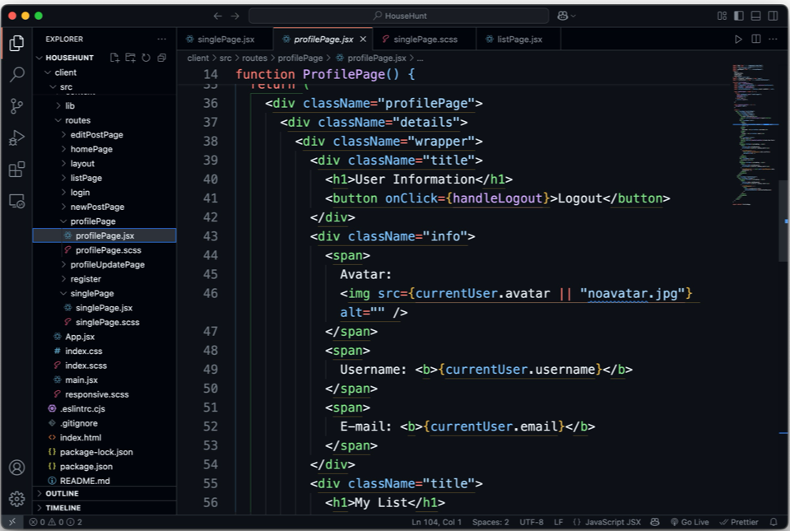
User Profile (Frontend)

Slide 18
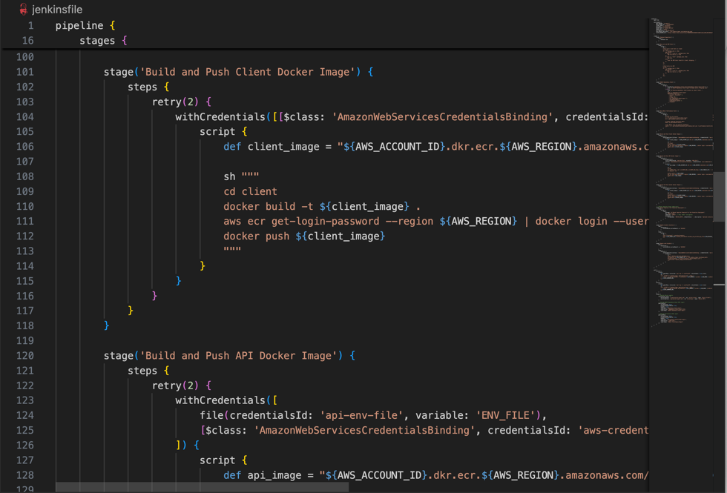
Jenkins

Slide 19

deployment

Slide 20
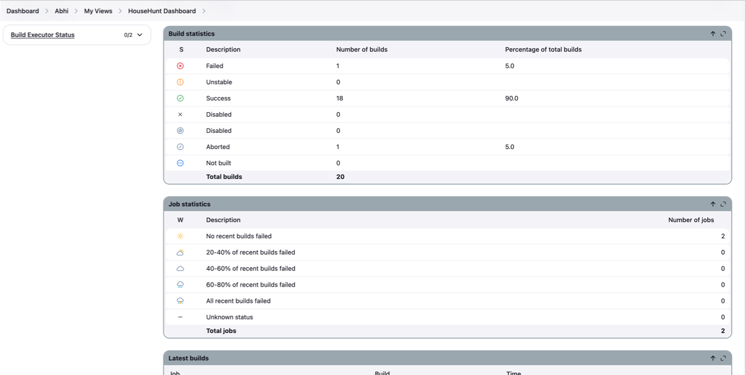
Jenkins Dashboard

Slide 21
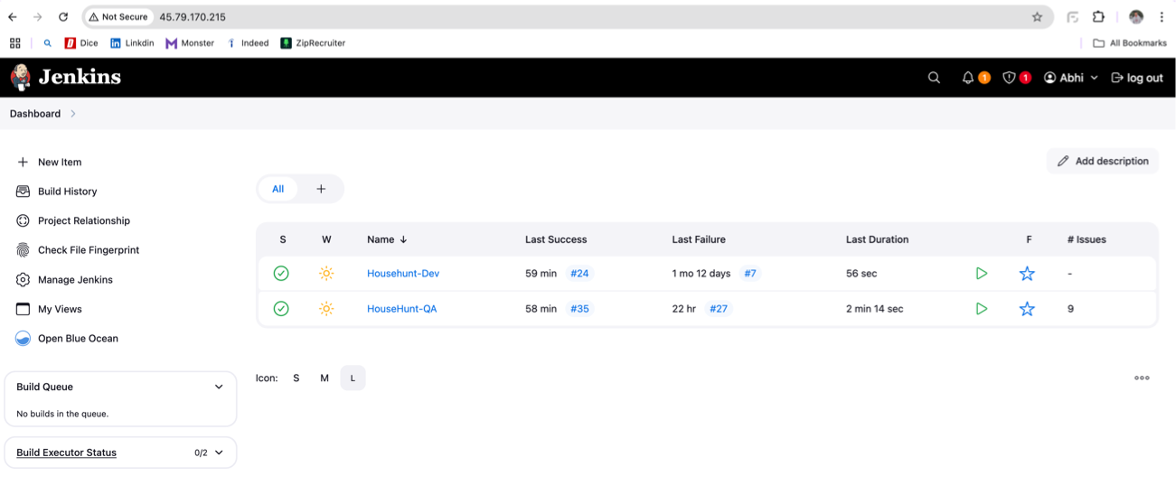
Pipeline

Slide 22
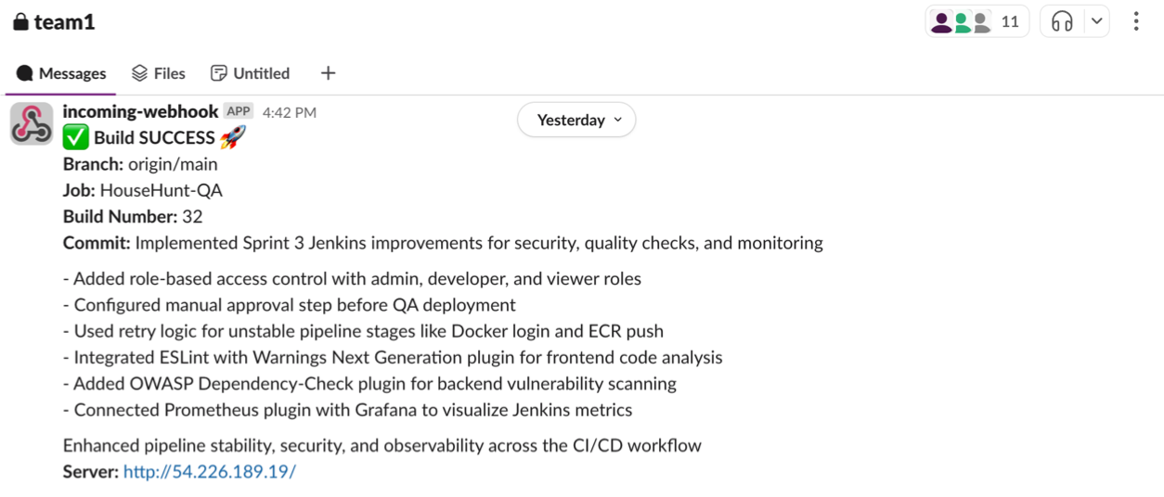
Slack Notification

Slide 23
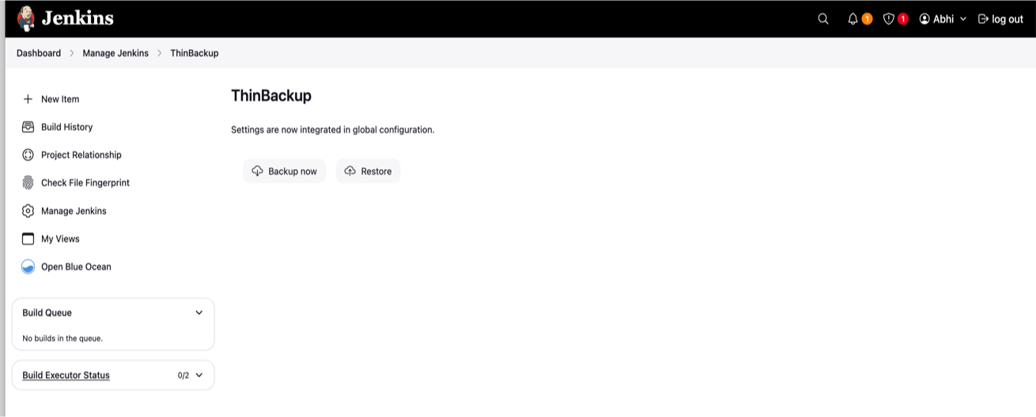
ThinBackup Plugin

Slide 24
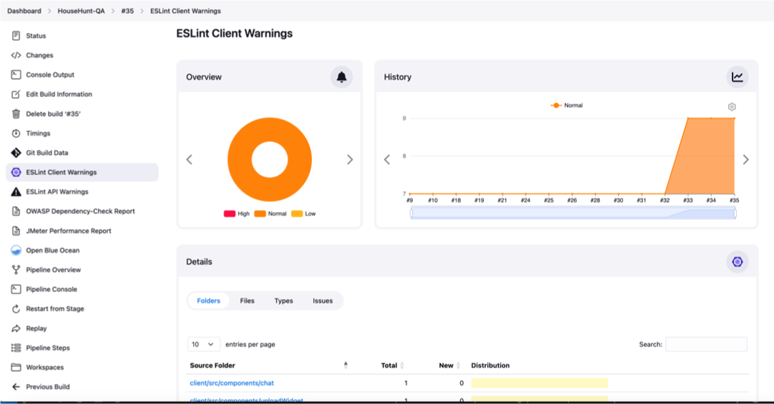
Warnings Next Generation Plugin

Slide 25
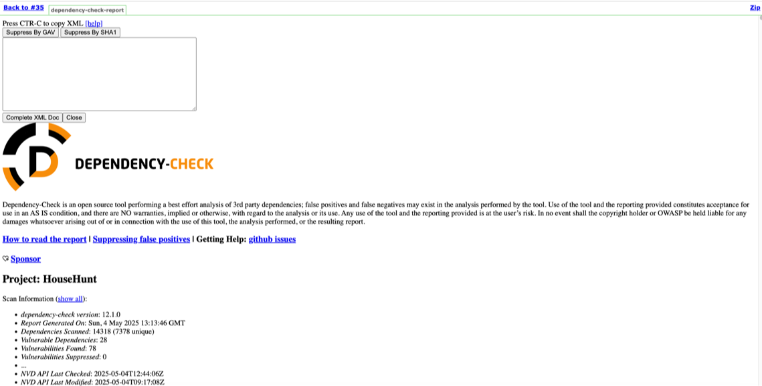
OWASP Dependency-Check Plugin

Slide 26
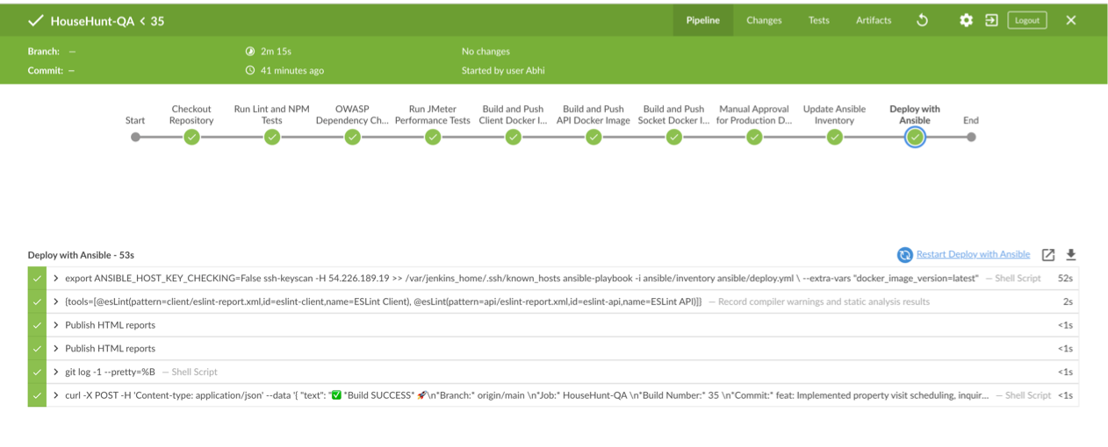
Blue Ocean Plugin

Slide 27
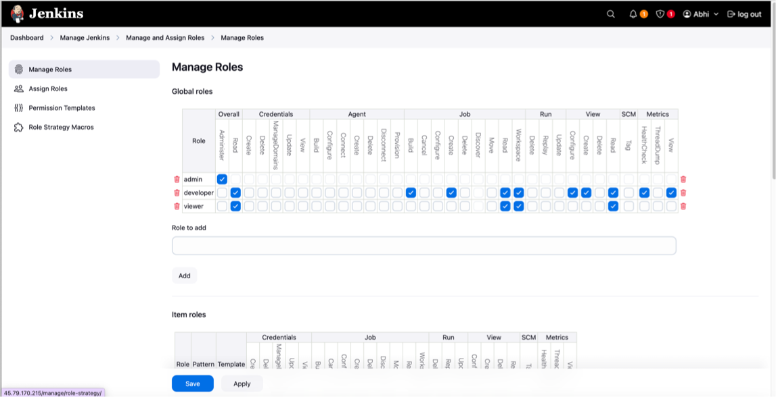
Role-Based Authorization

Slide 28
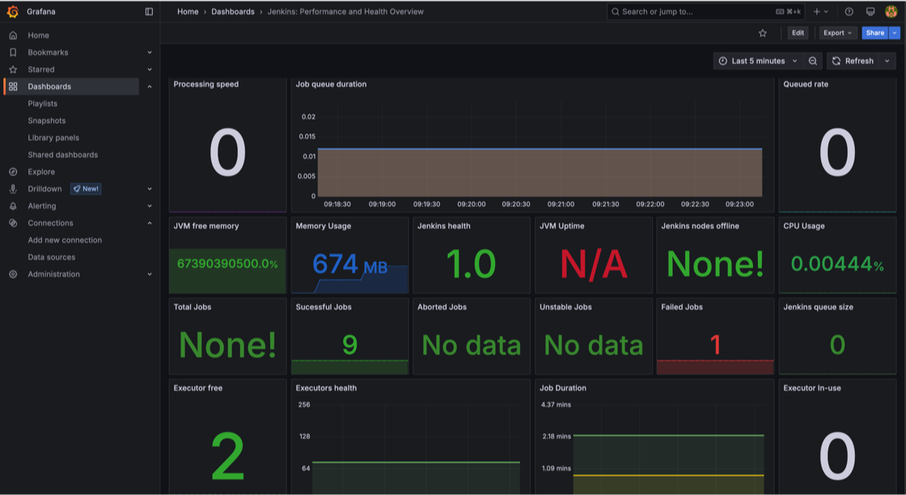
Grafana Dashboard

Slide 29

Thank you!

